Slide 1
API-RFQ “Configurator” Work Instructions December 2023

Slide 2
Content
API-Suite
Configurator description
Agent Process
Inside Sales Process

Slide 3
API Suite

Slide 4
API Suite
Leveraging automation to reduce transactional behavior, increase efficiency, productivity, and speed to market resulting in a better customer experience
Security Token
Request for Quote
Flip Quote to Order
Order Status
Get Product, Get Price

Slide 5
Configurator Description

Slide 6
API-RFQ Configurator Description
“Configurator” ​refers to the basis for building and pricing a fixture with standard options/accessories and rules to validate the configuration, like Lumec3D or LightXpress​
Approximately 135 product families; 35% of quoted lines
API-Configurator eliminates the need to reference price sheets for standard options based on current spec sheet​
Self-service: Agents can price jobs with confidence
Time savings: Immediate pricing without using tools outside the system, which reduces “non-value added” activities
Eliminates the need for NIS setup (3 days average savings at time of order)

Slide 7
Agent Process

Slide 8
API-RFQ Configurator (Oasis): Searching for Configurable Material
Create quote “project”
Add material using type-ahead functionality (min. 3 characters)
If the complete catalog code is found:
Click to add to quote
If the complete catalog code is not found:
Is configurator available? If so, use the tool to develop catalog code.

Slide 9
API-RFQ Configurator (Oasis): Searching for Configurable Material
Select the line on the bill of materials to configure.
Two ways of doing this:
1.) Tools -> Configurator
2.) SHIFT+F3 while selecting the line

Slide 10
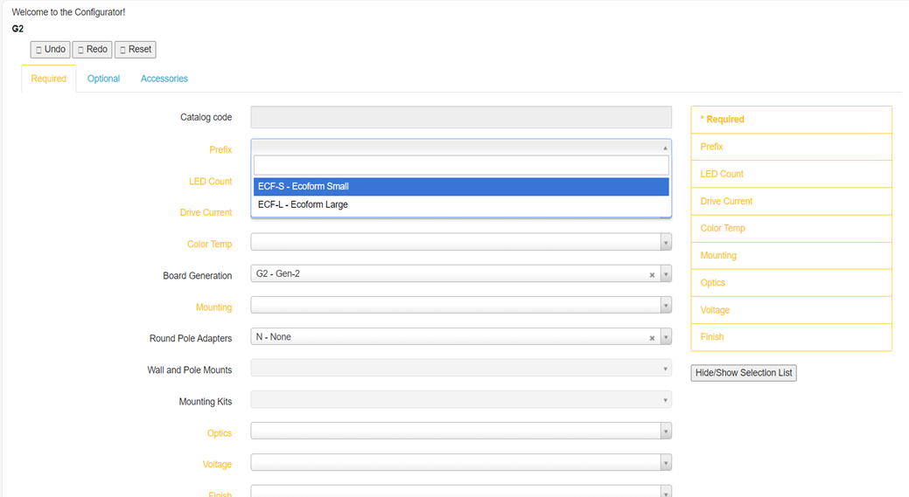
API-RFQ Configurator (Oasis): Selecting Options in Configurable Material
Configurator pop-out will show all valid standard options, as per spec sheet
Build the catalog number by selecting an option in each required category/variant (yellow fields)
Check the Optional and Accessories tabs for more selections

Slide 11
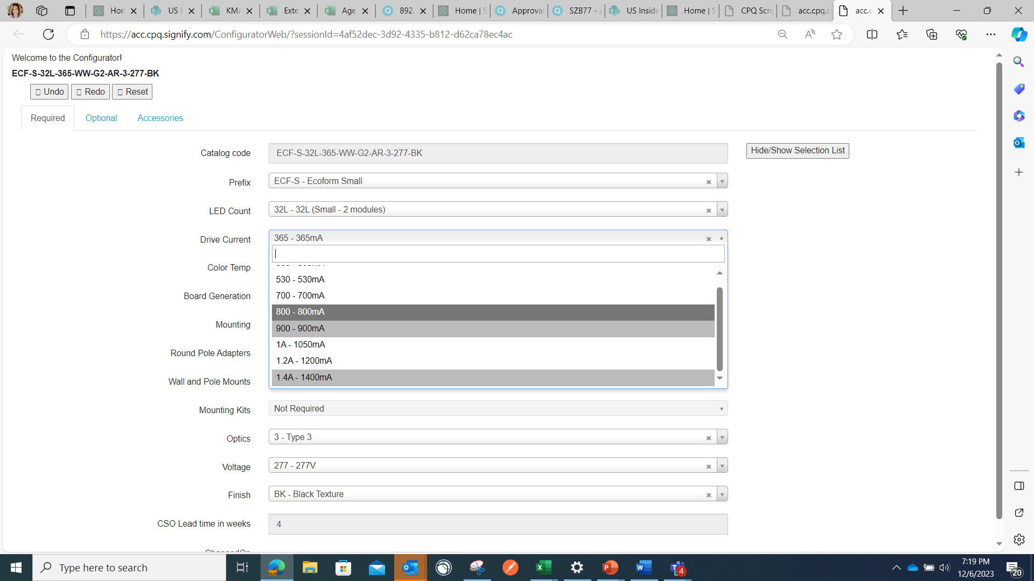
API-RFQ Configurator (Oasis): Selecting Options in Configurable Material
Valid options must be selected.
Grey options are not valid with previously determined criteria.

Slide 12
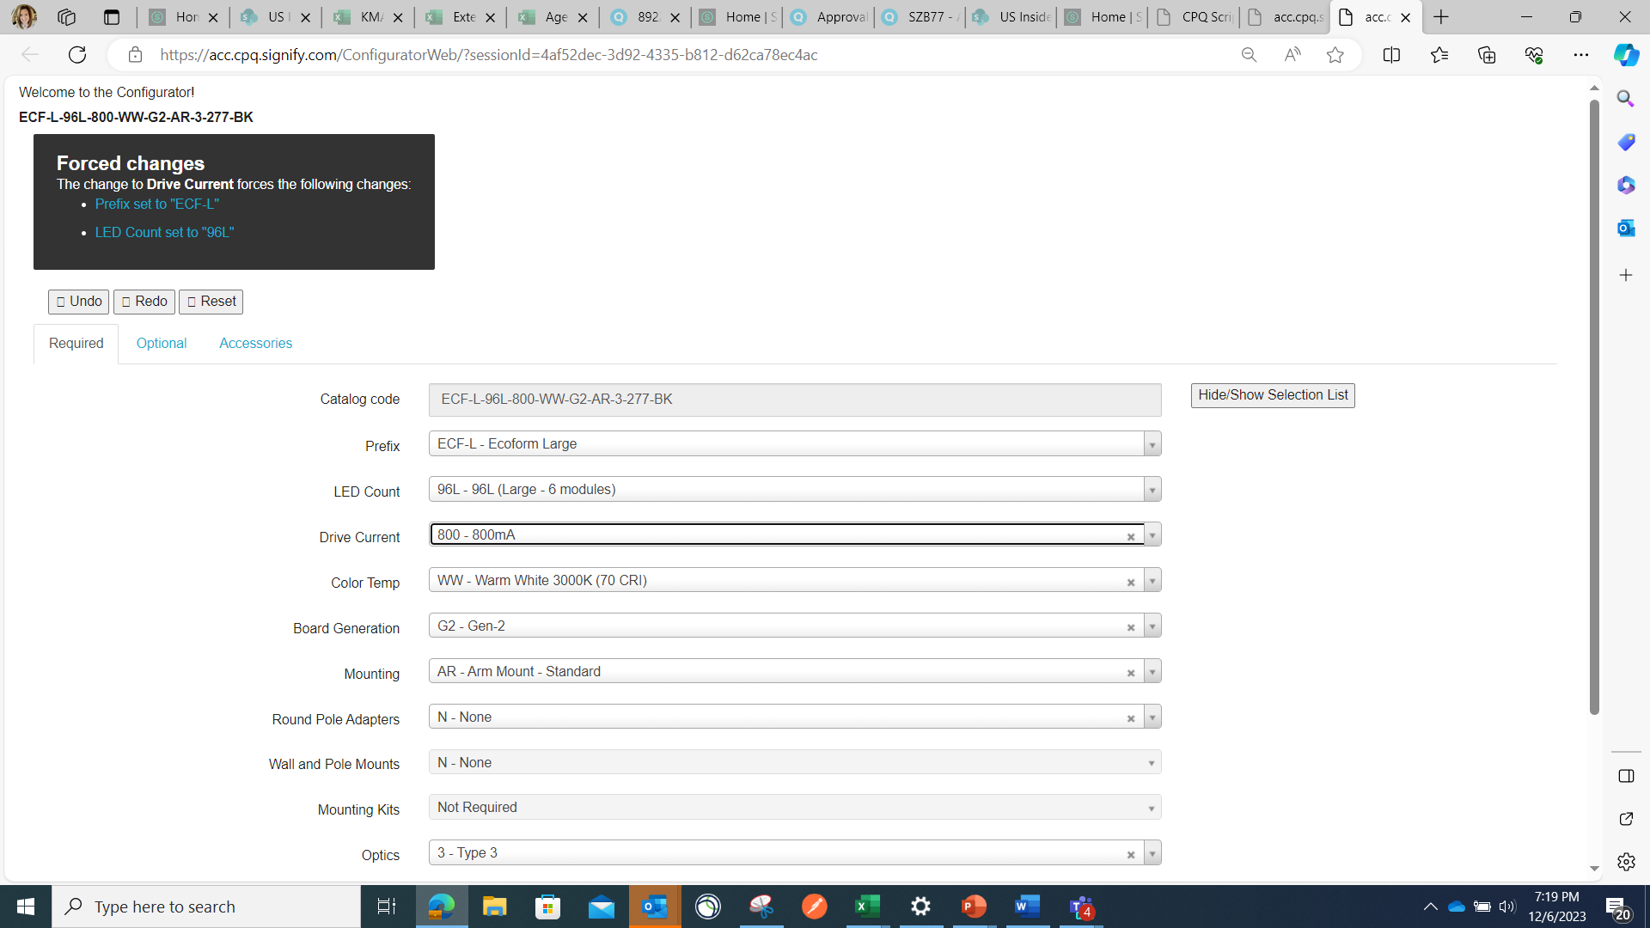
API-RFQ Configurator (Oasis): Selecting Options in Configurable Material
Forced changes message will pop up if an option is selected that is not valid with previously chosen criteria
Configurator will assume you want the most recent selection, so it will change the options from previous drop downs to make it a valid configuration

Slide 13
API-RFQ Configurator (Oasis): Selecting Options in Configurable Material
Check the Optional and Accessories tabs for more selections
Note: Accessories are NOT added automatically. The catalog code must be added manually as a separate line in the quote. (copy/paste future enhancement)
Add accessory as per spec sheet; do not include the description
BD – BIRD DETERRENT would be entered as “KIT, BIRD SPIKES”

Slide 14
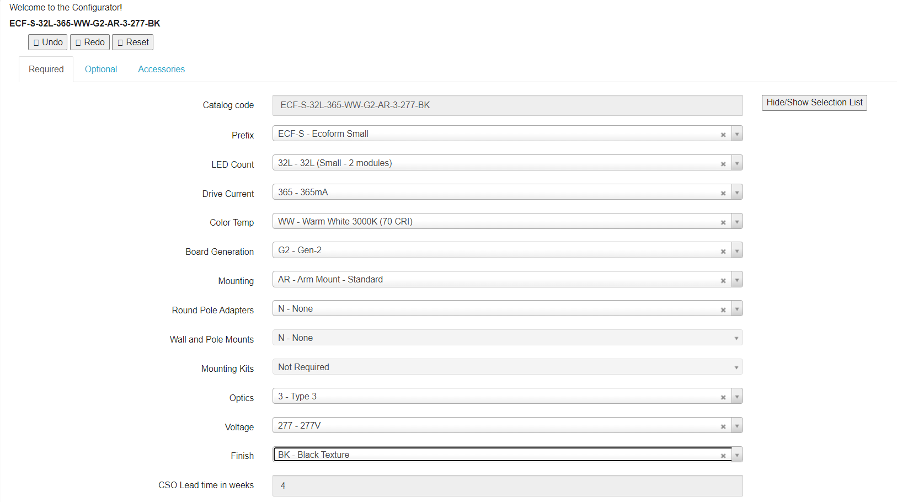
API-RFQ Configurator (Oasis): Selecting Options in Configurable Material
Once a valid configuration is built, the yellow fields will turn to black
Close out of the webpage to return to your quote

Slide 15
API-RFQ Configurator (Oasis): Result of adding Configurable line to quote
IMPORTANT: Click Signify and Return Configuration to bring in the configured catalog code and pricing details.
Continue adding bill of material to the project as usual. No change to the remaining RFQ process.
ECF-S-32L-365-WW-G2-AR-3-277-BK

