Slide 1

Welcome to the GLAZE Configurator!
Guide for Administrators and Users
This power-point was created to help set up your Agency to access GLAZE through Oasis.
Table of Content’s:
Pg. 2 What Version are you on?
Pg. 3-7 How to set the GLAZE Configurator settings
Pg. 8-15 How to import the LSI Industries Price List into Oasis
Pg. 16-21 Process for Adding and Locking Users in the GLAZE Configurator
Pg. 22-25 Accessing GLAZE from outside of Oasis

Slide 2
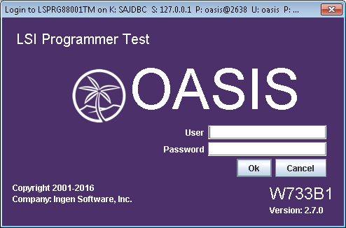
Your Oasis Version must be W733B1 or Greater Link below
Here are two links that will answer any Version Update questions:
What release am I on?
http://www.ingensoftware.com/MainSite/wiki.jsp?page=313
Changing versions in Oasis (this is actually on reverting, but same concept)
http://www.ingensoftware.com/MainSite/wiki.jsp?page=155

Slide 3
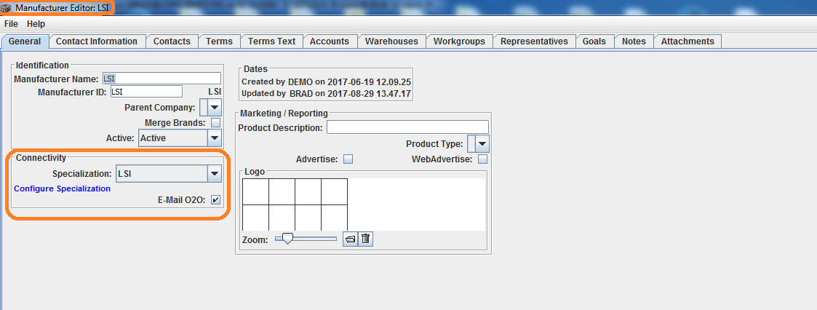
Go into the Manufacturer settings for LSI
Make sure Connectivity Specialization setting is set to LSI
Email 020 Must Be Checked!
4. Click on “Configure Specialization”.

Slide 4
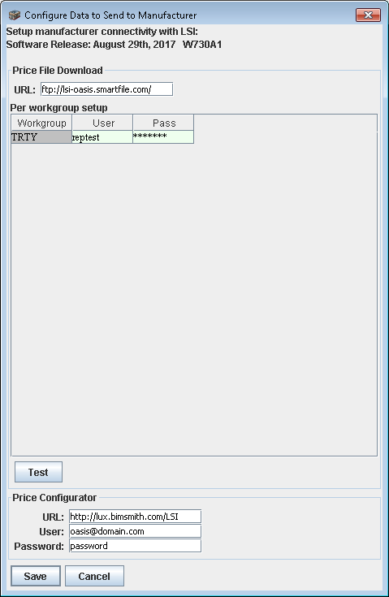
5. Setup the Price Configurator settings below, save them.
Substitute with oasisReps#@domain log in from e-mail notification
Your password was sent to you in the e-mail notification

Slide 5
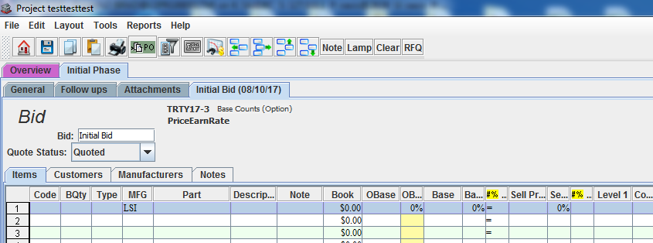
6. Open a project
7. Put in LSI on a line as the manufacturer, and highlight the line.

Slide 6
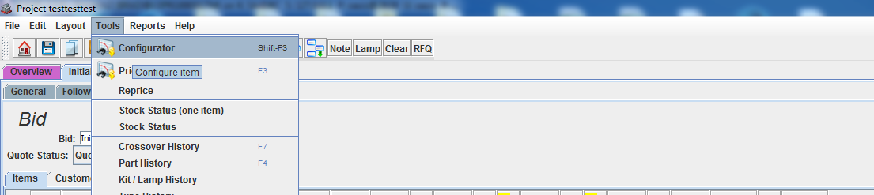
8. Then click “Tools -> Configurator” (Or keyboard shortcut to Shift F3)

Slide 7
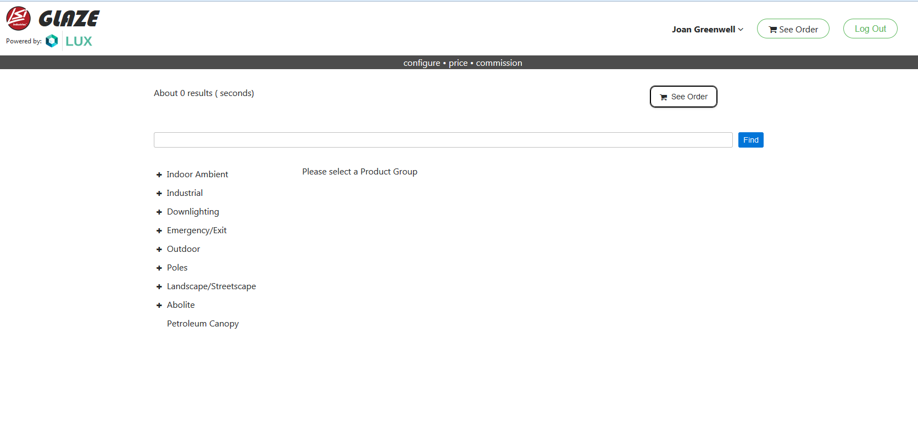
9. This will open the Configurator in Oasis.

Slide 8
Accessing additional pricing that’s not in GLAZE
We have loaded around 120 product families into GLAZE already and are continually adding more. However there are some legacy products that we will not be loading. Pricing for products not in GLAZE will continue to be accessed in the way you’ve historically done using the FTP site.
It’s important that you download the latest price list to ensure that GLAZE and the FTP list will work together properly.
Instructions for the FTP download are on the following slides.

Slide 9
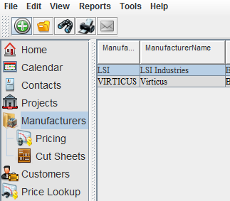
How to import the LSI Industries Price List into Oasis
Select Manufacturers from the menu on the right side of the screen.
Double click Pricing under Manufacturers.
1
2

Slide 10
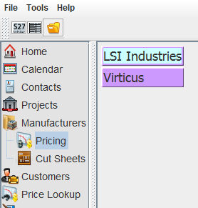
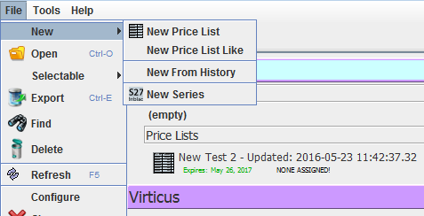
3. Select LSI Industries
4. From the menu on the top left, click File
5. On the drop down menu point to New
6. Click New Price List
4
5
6
3

Slide 11
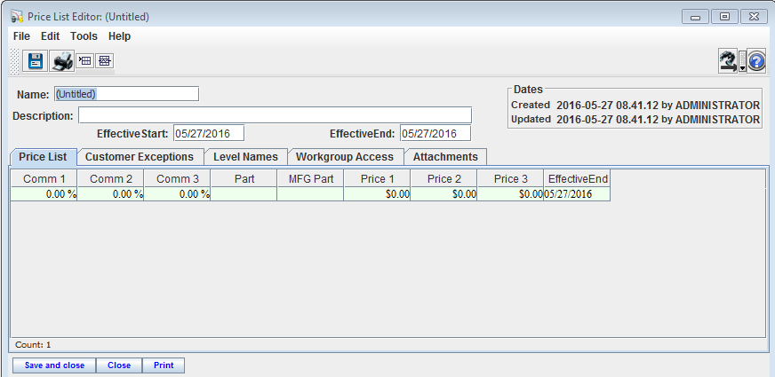
7. Enter a name for the price list
8. Enter a description for the price list
9. Click Save and close in the bottom left corner.
10. Click the Cancel button on the popup about the effective date
11. Click the Make Active button on the popup about activating the price list.
7
8
9

Slide 12
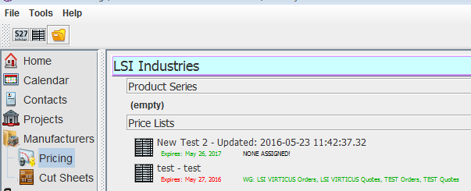
12. To see the new price list, double click on LSI Industries
13. Click once on the new price list to select it
12
13

Slide 13
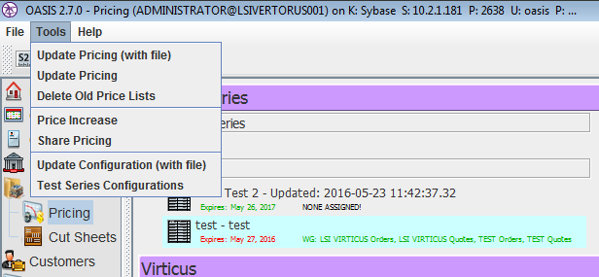
14. With the new price list selected, click Tools on the menu on the top left of Oasis.
15. Click Update Pricing on the dropdown menu
14
15

Slide 14


16. You should see a download message at the bottom right side of your screen as shown below
17. Watch for the next message to appear in the same place. It will only appear for a few seconds
18. When you see the message shown below, the price list has finished downloading.

Slide 15
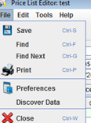
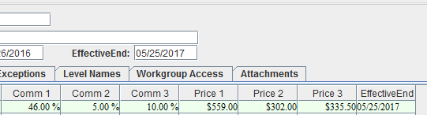
19. Double click on the new price list to open it
20. From the Price List tab of the Price list, click File on the top menu to display a dropdown menu
21. Select discover data to remove any unused columns and display all used columns
22. In the header of the price list enter into the Effective End field the same date that is displayed in the Effective End date of the price list.
20
21
22

Slide 16

Process for Adding and Locking Users in the GLAZE Configurator

Slide 17
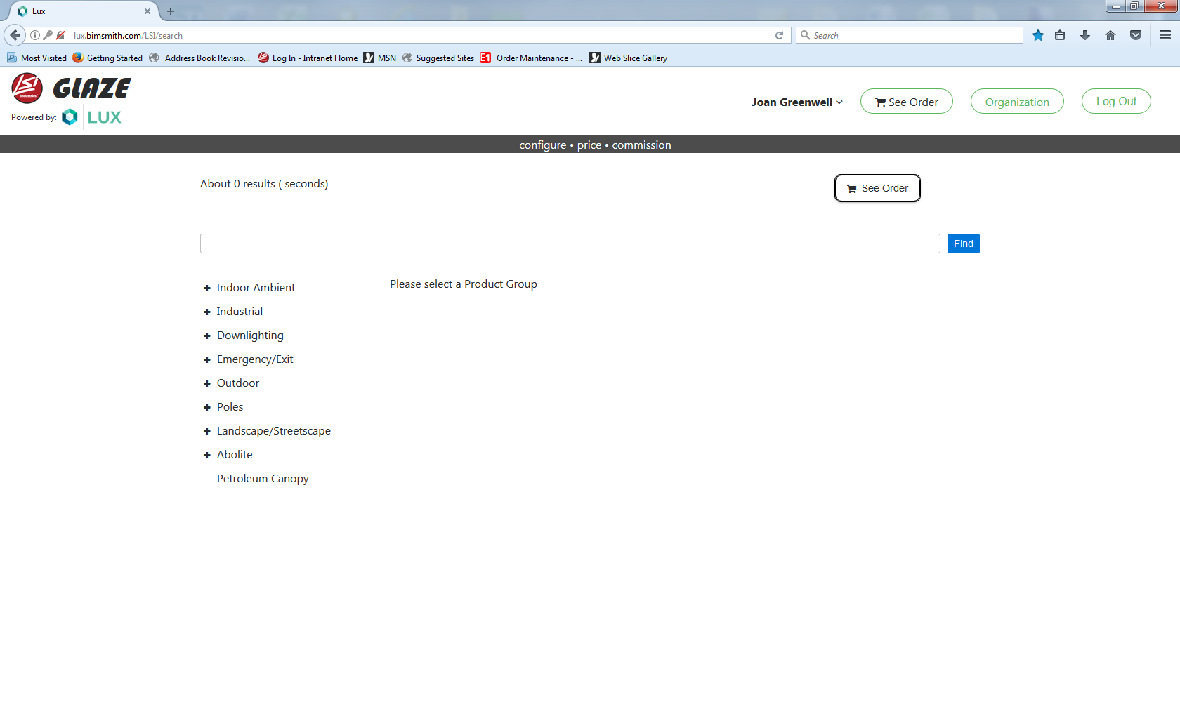
Click on Organization

Slide 18
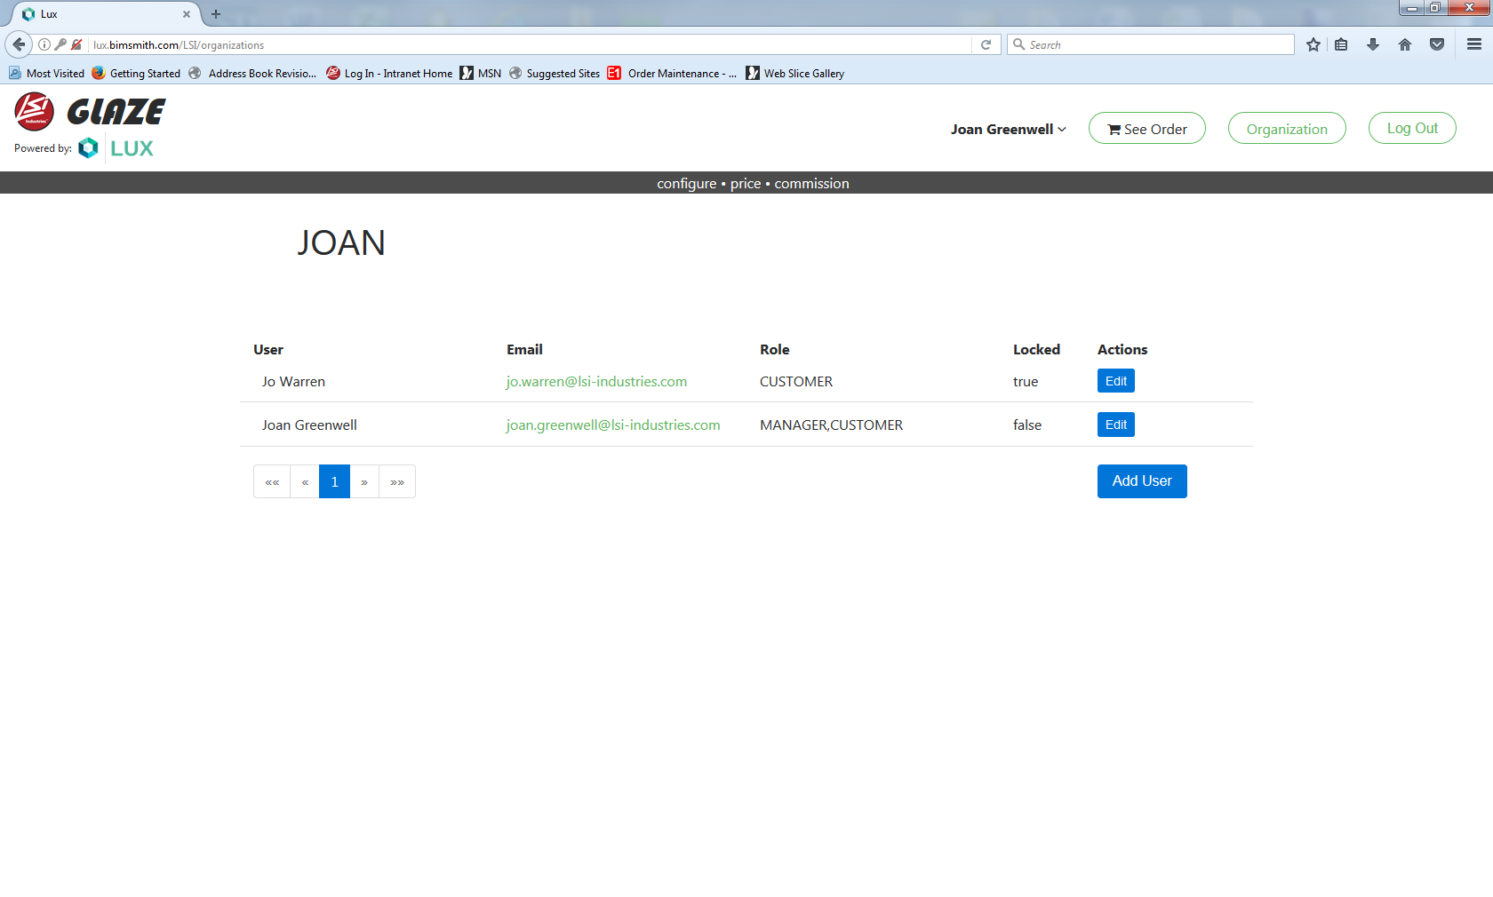
Adding a User: Select the Add User button

Slide 19
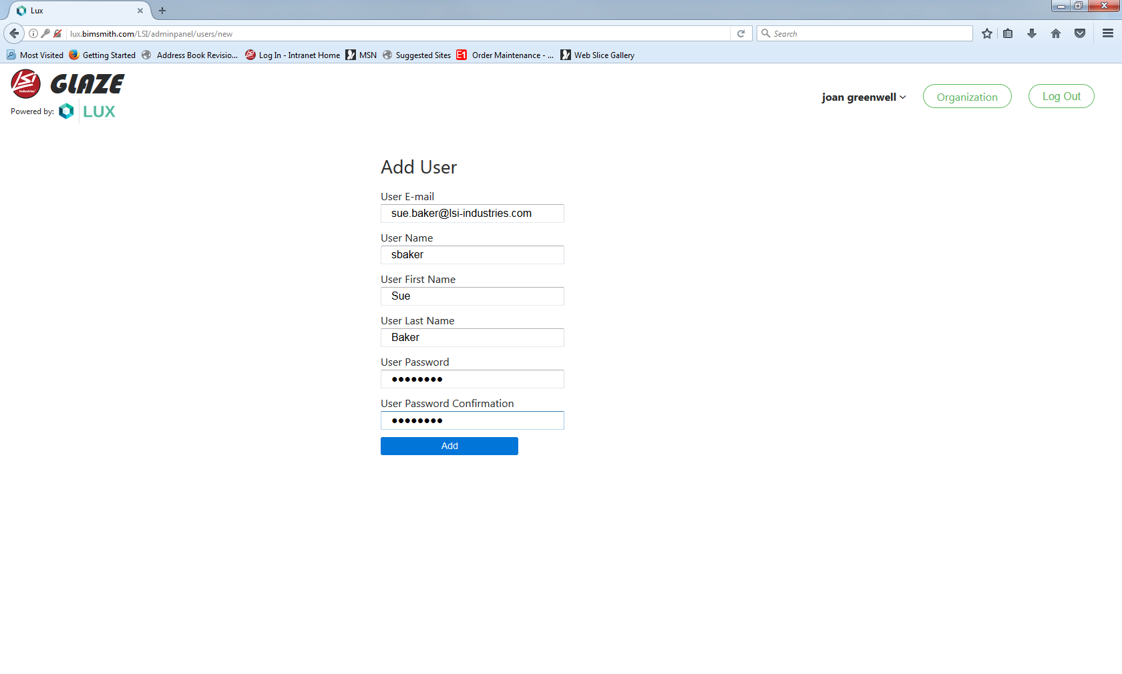
Fill out all field’s and Select Add

Slide 20

To Lock a user from using the Configurator:
Select Edit on the User you need to lock

Slide 21
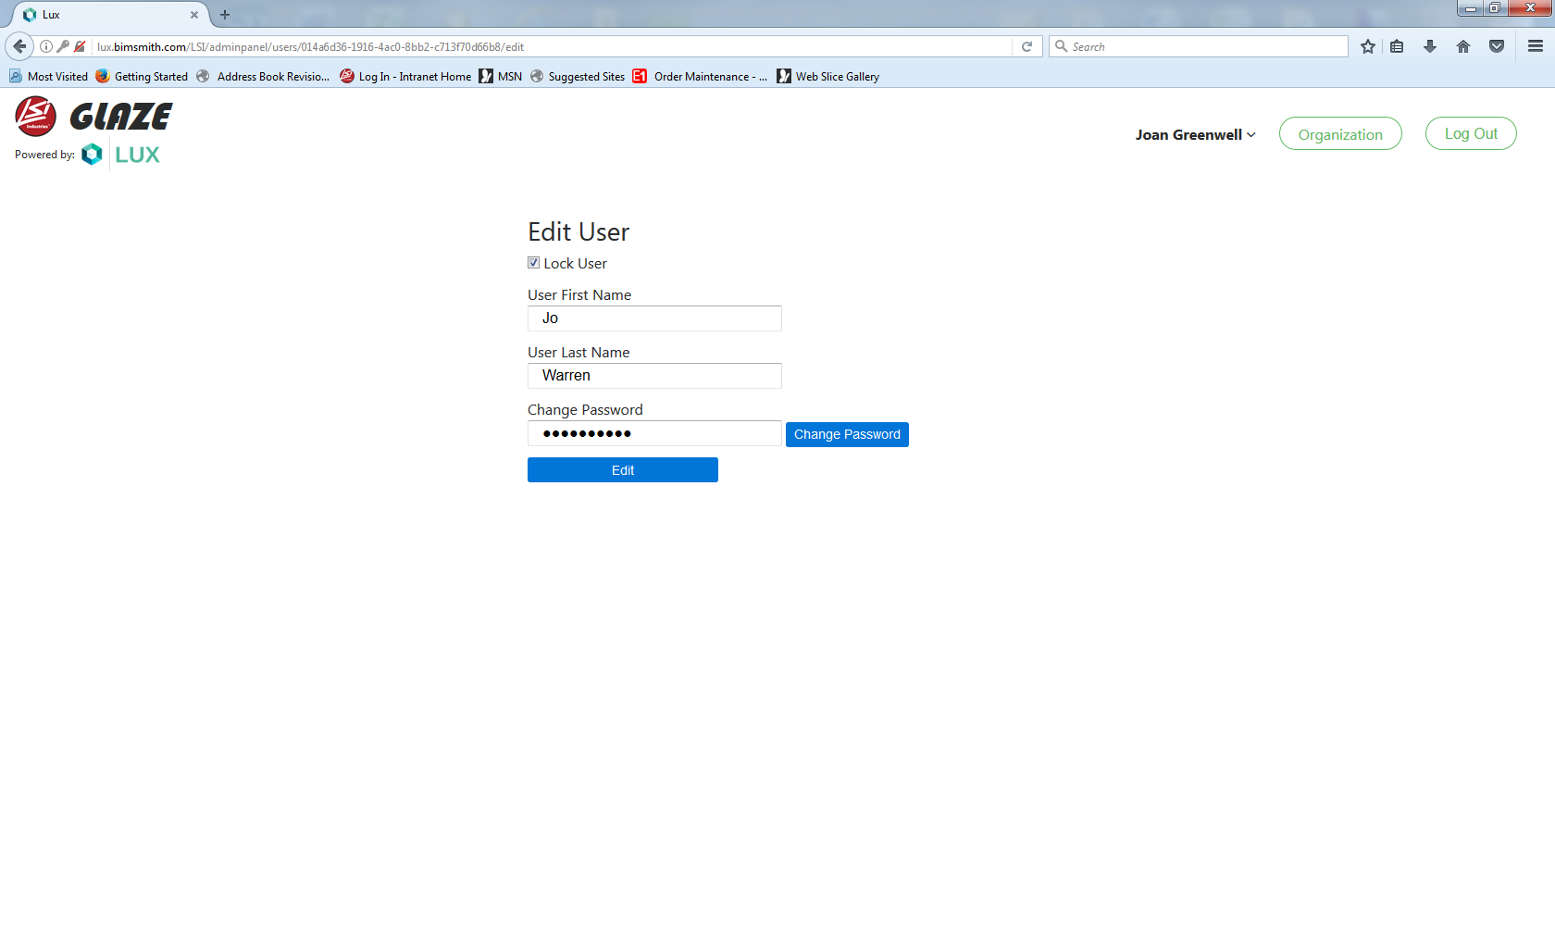
Select Lock User Box and then select Edit
*After 30 days the system will purge the locked users *

Slide 22
Process for accessing GLAZE outside of Oasis

Slide 23
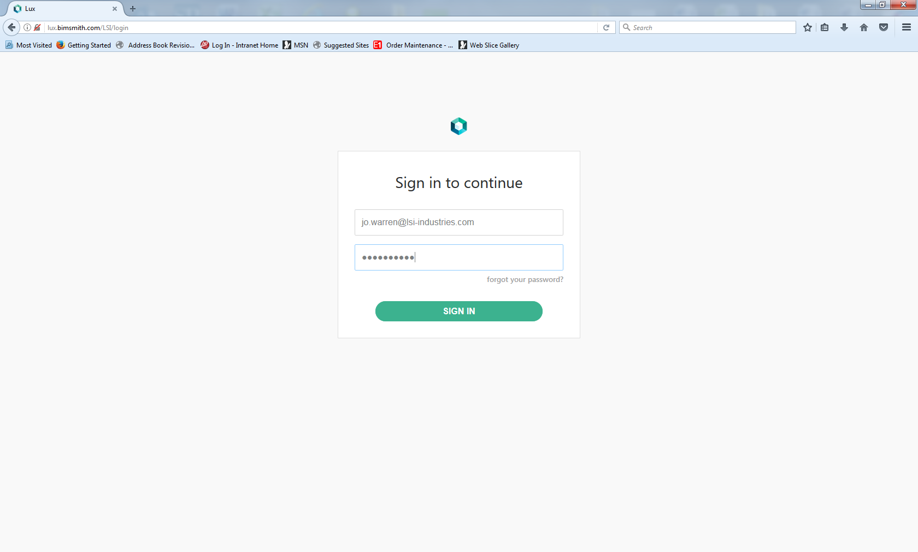
Go to the Configurator Web Link: lux.bimsmith.com/LSI/login

Slide 24
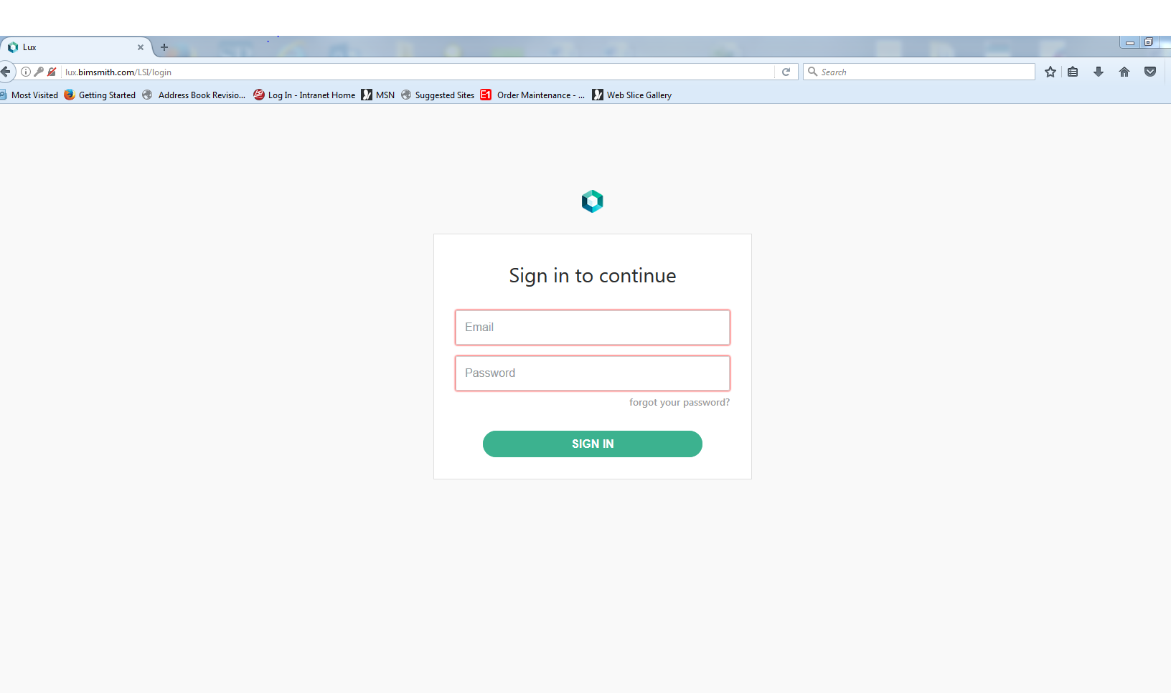
1. Use your Email address
2. Password
Set Up by LSI
3. Click on

Slide 25
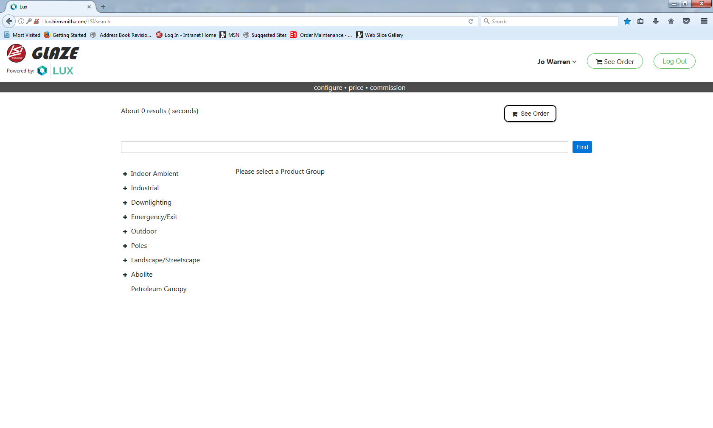
Start Configuring your LSI Order!

